Slide 1
Week 3 CIS 215
enumeration

Slide 2
What is enumeration?
This is where we use the info from Recon
Recon helps us see the whole company
Enumeration is capturing and tracking info on to help us make the battle plan
We might want extra info for exploitation phase
Such as usernames and hostnames
IPtables and routing rules
Deeper recon, but more focused in specific places instead of building a general vision of the company

Slide 3

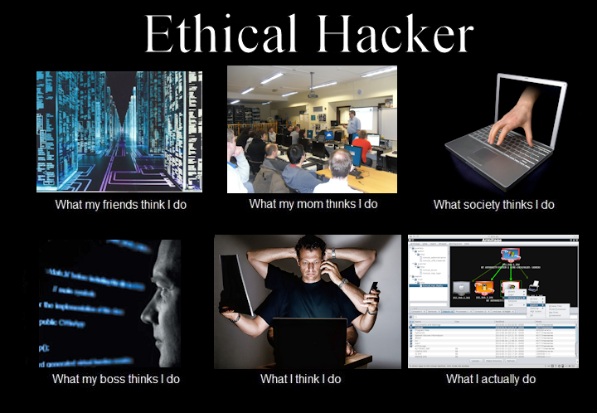
Choose Targets
Jobs (CFO, CEO, VP...)
Servers
Devices
People

Slide 4

Activity
Let's pick 4 targets, 2 people 2 hardware/software
Come up with reasons why these are our potential targets

Slide 5

Layers
We don't want to put all our "eggs" in one basket
List what is most likely to get detected to least likely and scale up
Include a timing plan as well
Battle plan is 1 piece, the other is deeper recon
What do we think is best to go after? How do we go after it?

Slide 6
Social Engineering
Phishing emails
Tailor emails to people
Tailored emails to company (ISO27000 report)
Vishing phone calls
Mumble attack (mumble and hope they give extra info)
Technical Jargon to convince you're ok
Social media
Attack surface mapper and Social Attacker by Jacob Wilkin (Written in Python)

Slide 7
Hardware
Server
Mapping
Ping and ports
Nmap
Zenmap
OS
Banners – info about system, services and open ports. Shows version of application and OS that's being run usually done on ports 80,21, and 25
Location of hardware
Network structure vs desktop vulnerabilities
Forgotten hardware (Printers, fax, unauthorized workarounds)

Slide 8
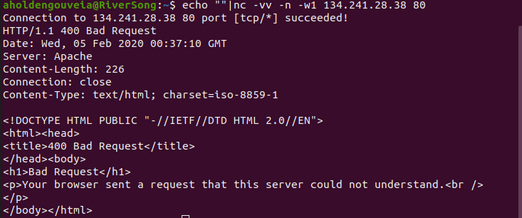
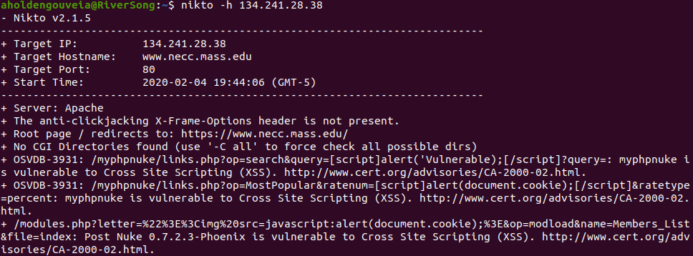
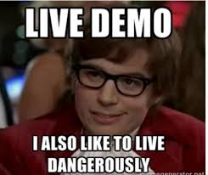
Activity
Try using Netcat (nc) to grab the banner
Try using nikto on the website
Try wpscan on the website NO enumeration switch!

Slide 9

Avoiding detection
Stealth mode and idle scanning
Nmap is LOUD has stealth options
Syn/ack vs fin packets
Spoofing and zombies
Forged packets
Decoys and distractions
Volume attacks
Identify systems, triggers, and traps

Slide 10
Activity
Let's try more tools!
TheHarvester
500 results MAX
Let's just try an email address to start
P0f
Passive tool
Used for things like routine networking monitoring, finding unauthorized network connects and do network fingerprinting
Uniscan

